Slide 1
LANs & WANs
Internet & Internet Technologies

Slide 2
IEEE LAN Standards
WAN Standards
Transmission Media
Transmission Types.

Slide 3
IEEE LAN Standards
IEEE LAN/MAN 802® Standards
Access the growing collection of IEEE 802® standards used worldwide.
750+ active, draft, and archived standards in personal, local and metropolitan area network interfaces for evolving wired, and wireless networking technologies
Robust search tools powered by the intuitive IEEE Xplore digital library
E-mail alerts and updates regarding new standards and drafts
IEEE Redline Versions of Standards

Slide 4
IEEE 802 standards are restricted to networks carrying variable-size packets
“By contrast, in cell relay networks data is transmitted in short, uniformly sized units called cells. Isochronous networks, where data is transmitted as a steady stream of octets, or groups of octets, at regular time intervals, are also out of the scope of this standard.”

Slide 5
cell relay refers to a method of statistically multiplexing small fixed-length packets, called "cells", to transport data between computers or kinds of network equipment. It is an unreliable, connection-oriented packet switched data communications protocol.
an isochronous signal is a signal in which the time interval separating any two significant instants is equal to the unit interval or a multiple of the unit interval. Variations in the time intervals are constrained within specified limits.
"Isochronous" is a characteristic of one signal, while "synchronous" indicates a relationship between two or more signals.

Slide 6
The services and protocols specified in IEEE 802 map to the lower two layers (Data Link and Physical) of the seven layer OSI networking reference model. In fact, IEEE 802 splits the OSI Data Link Layer into two sub-layers named
LLC Sub-layer
MAC Sub-layer

Slide 7
LLC
The LLC sublayer is primarily concerned with:
Multiplexing protocols transmitted over the MAC layer (when transmitting) and decoding them (when receiving).
Providing node-to-node flow and error control
In today's networks, flow control and error management is typically taken care of by a transport layer protocol such as the TCP protocol, or by some application layer protocol, in an end-to-end fashion, i.e. retransmission is done from source to end destination. This implies that the need for LLC sub-layer flow control and error management has reduced. LLC is consequently only a multiplexing feature in today's link layer protocols. An LLC header tells the data link layer what to do with a packet once a frame is received. It works like this: A host will receive a frame and look in the LLC header to find out to what protocol stack the packet is destined - for example, the IP protocol at the network layer or IPX (Internetwork Packet Exchange). However, today most non-IP network protocols are abandoned.

Slide 8
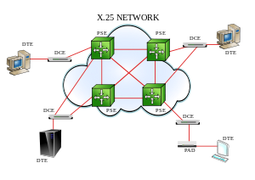
Application examples
X.25 is an ITU-T standard protocol suite for packet switched wide area network (WAN) communication. An X.25 WAN consists of packet-switching exchange (PSE) nodes as the networking hardware, and leased lines, plain old telephone service connections or ISDN connections as physical links. X.25 is a family of protocols that was popular during the 1980s with telecommunications companies and infinancial transaction systems such as automated teller machines. X.25 was originally defined by the International Telegraph and Telephone Consultative Committee (CCITT, now ITU-T) in a series of draftsand finalized in a publication known as The Orange Book in 1976.

Slide 9
Local area network (LAN) and metropolitan area network (MAN) protocols
The IEEE 802.2 standard specifies LLC sublayer for all IEEE 802 local area networks, such as IEEE 802.3/Ethernet (if the EtherType field is used), IEEE 802.5, and IEEE 802.11, and in some non-IEEE 802 networks such as FDDI.
Ethernet
Since bit errors are very rare in wired networks, Ethernet does not provide flow control or automatic repeat request (ARQ), meaning that incorrect packets are detected but only cancelled, not retransmitted (except in case of collisions detected by the CSMA/CD MAC layer protocol). Instead, retransmissions rely on higher layer protocols.
As the Ethertype in an Ethernet II framing formatted frame is used to multiplex different protocols on top of the Ethernet MAC header it can be seen as LLC identifier. However, If Ethernet is used without EtherType field, Ethernet is considered as lacking LLC sublayer.
Wireless LAN
In wireless communications, bit errors are very common. In wireless networks such as IEEE 802.11, flow control and error management is part of the CSMA/CA MAC protocol, and not part of the LLC layer. The LLC sublayer follows the IEEE 802.2 standard.

Slide 10
HDLC(High-Level Data Link Control)
Some non-IEEE 802 protocols can be thought of as being split into MAC and LLC layers. For example, while HDLC specifies both MAC functions (framing of packets) and LLC functions (protocol multiplexing, flow control, detection, and error control through a retransmission of dropped packets when indicated), some protocols such as Cisco HDLC can use HDLC-like packet framing and their own LLC protocol.
PPP and modems
Over telephone network modems, PPP (Point-to-point Protocal) link layer protocols can be considered as a LLC protocol, providing multiplexing, but it does not provide flow control and error management. In a telephone network, bit errors might be common, meaning that error management is crucial, but that is today provided by modern protocols. Today's modem protocols have inherited LLC features from the older LAPM link layer protocol, made for modem communication in old X.25 networks.
Cellular systems
The GPRS (General packet radio service) LLC layer also does ciphering and deciphering of SN-PDU Sub Network Dependent Convergence Protocol (SNDCP) packets. It also performs compression of NPDUs to make for efficient Data transmission.
Power lines
Another example of a data link layer which is split between LLC (for flow and error control) and MAC (for multiple access) is the ITU-T( International Telecommunication Union) G.hn standard, which provides high-speed local area networking over existing home wiring (power lines, phone lines and coaxial cables).

Slide 11
MAC
Media access control (MAC) data communication protocol is a sublayer of the data link layer, which itself is layer 2. The MAC sublayer provides addressing and channel access control mechanisms that make it possible for several terminals or network nodes to communicate within a multiple access network that incorporates a shared medium, e.g. Ethernet. The hardware that implements the MAC is referred to as a medium access controller.
The MAC sublayer acts as an interface between the logical link control (LLC) sublayer and the network's physical layer. The MAC layer emulates a full-duplex logical communication channel in a multi-point network. This channel may provide unicast, multicast or broadcast communication service.

Slide 12
Functions performed in the MAC sublayer
According to 802.3-2002 section 4.1.4, the functions required of a MAC are:
receive/transmit normal frames
half-duplex retransmission and backoff functions
append/check FCS (frame check sequence)
Inter-frame gap enforcement
discard malformed frames
append(tx)/remove(rx) preamble, SFD, and padding
half-duplex compatibility: append(tx)/remove(rx) MAC address

Slide 13
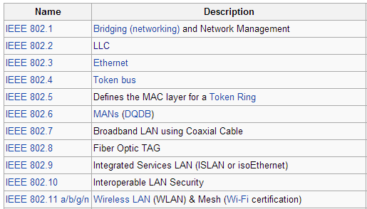
Working groups of IEEE Standard
distributed-queue dual-bus network

Slide 14
Wide area network standards
Wide area network standards
A wide area network (WAN) is a data communications network designed to serve an area of hundreds or thousands of miles--for example, public and private packet-switching networks, and national telephone networks.
These topics introduce the types of wide area networks that are supported by the iSeries™ system:
Asynchronous communications
Binary synchronous communications
Frame relay
Synchronous data link control network
X.25 network
X.21 network

Slide 15
IEEE 802.11 Standard
802.11 Standards
802.11 - The original WLAN standard
802.11a - High speed WLAN standard for 5GHz band, supports up to 54mbps
802.11b - WLAN Standard for 2.4GHz band, supports 11mbps
802.11e - Describes QoS, Quality of Service requirements for all IEEE WLAN radio interfaces
802.11f - Defines inter-access point communications to facilitate multiple vendor-distributed WLAN networks
802.11g - Defines an additional modulation technique for 2.4 Ghz band. Intended to provide speeds up to 54 Mbps.
802.11h - Defines the spectrum management of the 5 Ghz band for use in Europe and in Asia Pacific.
802.11i - Address the current security weaknesses for both authentication and encryption protocols.

Slide 16
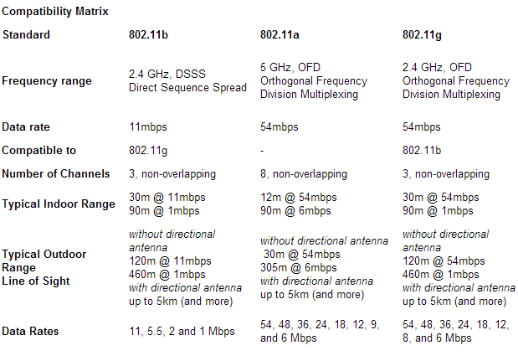

Slide 17
802.11a Standard
802.11a, is much faster than 802.11b, with a 54Mbps maximum data rate operates in the 5GHz frequency range and allows eight simultaneous channels.
802.11a uses Orthogonal Frequency Division Multiplexing (OFDM), an encoding scheme that offers benefits over spread spectrum in channel availability and data rate.
Channel availability is significant because the more independent channels that are available, the more scalable the wireless network becomes. 802.11a uses OFDM to define a total of 8 non-overlapping 20 MHz channels across the 2 lower bands. By comparison, 802.11b uses 3 non-overlapping channels.
All wireless LANs use unlicensed spectrum; therefore they're prone to interference and transmission errors. To reduce errors, both types of 802.11 automatically reduce the Physical layer data rate. IEEE 802.11b has three lower data rates (5.5, 2, and 1Mbit/sec), and 802.11a has seven (48, 36, 24, 18, 12, 9, and 6Mbits/sec). Higher (and more) data rates aren't 802.11a's only advantage. It also uses a higher frequency band, 5GHz, which is both wider and less crowded than the 2.4GHz band that 802.11b shares with cordless phones, microwave ovens, and Bluetooth devices

Slide 18
802.11b Standard
With 802.11b WLANs, mobile users can get Ethernet levels of performance, throughput, and availability.
The basic architecture, features, and services of 802.11b are defined by the original 802.11 standard. The 802.11b specification affects only the physical layer, adding higher data rates and more robust connectivity.
The key contribution of the 802.11b addition to the wireless LAN standard was to standardize the physical layer support of two new speeds,5.5 Mbps and 11 Mbps.

Slide 19
802.11g Standard
Though 5GHz has many advantages, it also has problems. The most important of these is compatibility:
The different frequencies mean that 802.11a products aren't interoperable with the 802.11b base. To get around this, the IEEE developed 802.11g, which should extend the speed and range of 802.11b so that it's fully compatible with the older systems.
The standard operates entirely in the 2.4GHz frequency, but uses a minimum of two modes (both mandatory) with two optional modes [ Wireless Standards Up in the Air].
The obvious advantage of 802.11g is that it maintains compatibility with 802.11b (and 802.11b's worldwide acceptance) and also offers faster data rates comparable with 802.11a. The number of channels available, however, is not increased, since channels are a function of bandwidth, not radio signal modulation

